Slide 1
Single Page Applications
With Knockout.JS

Slide 2
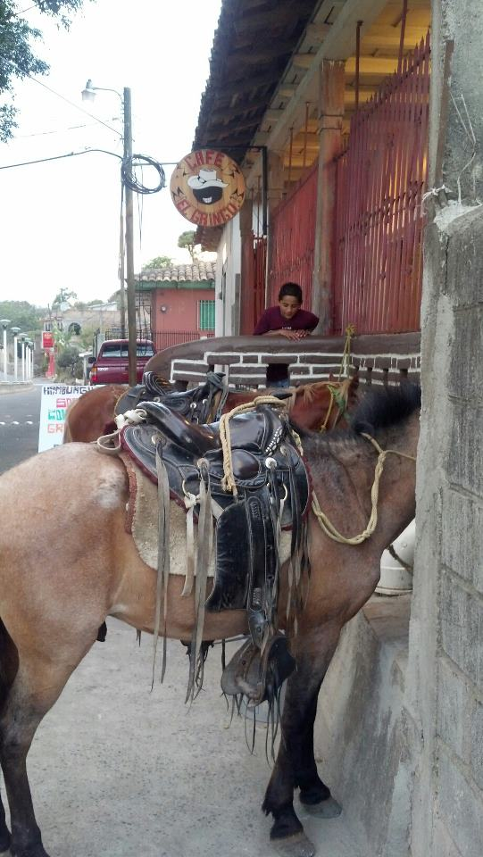
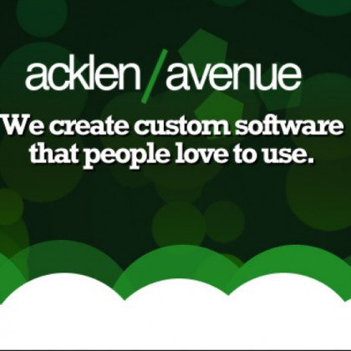

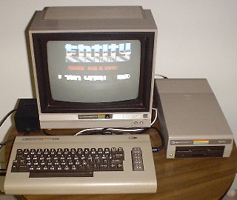

Who am I?
Software Engineer for 15+ years
Senior Architect at Acklen Avenue
I love software development!
Married to Pamela, live in Santa Ana
Owner of Café El Gringo

Slide 3
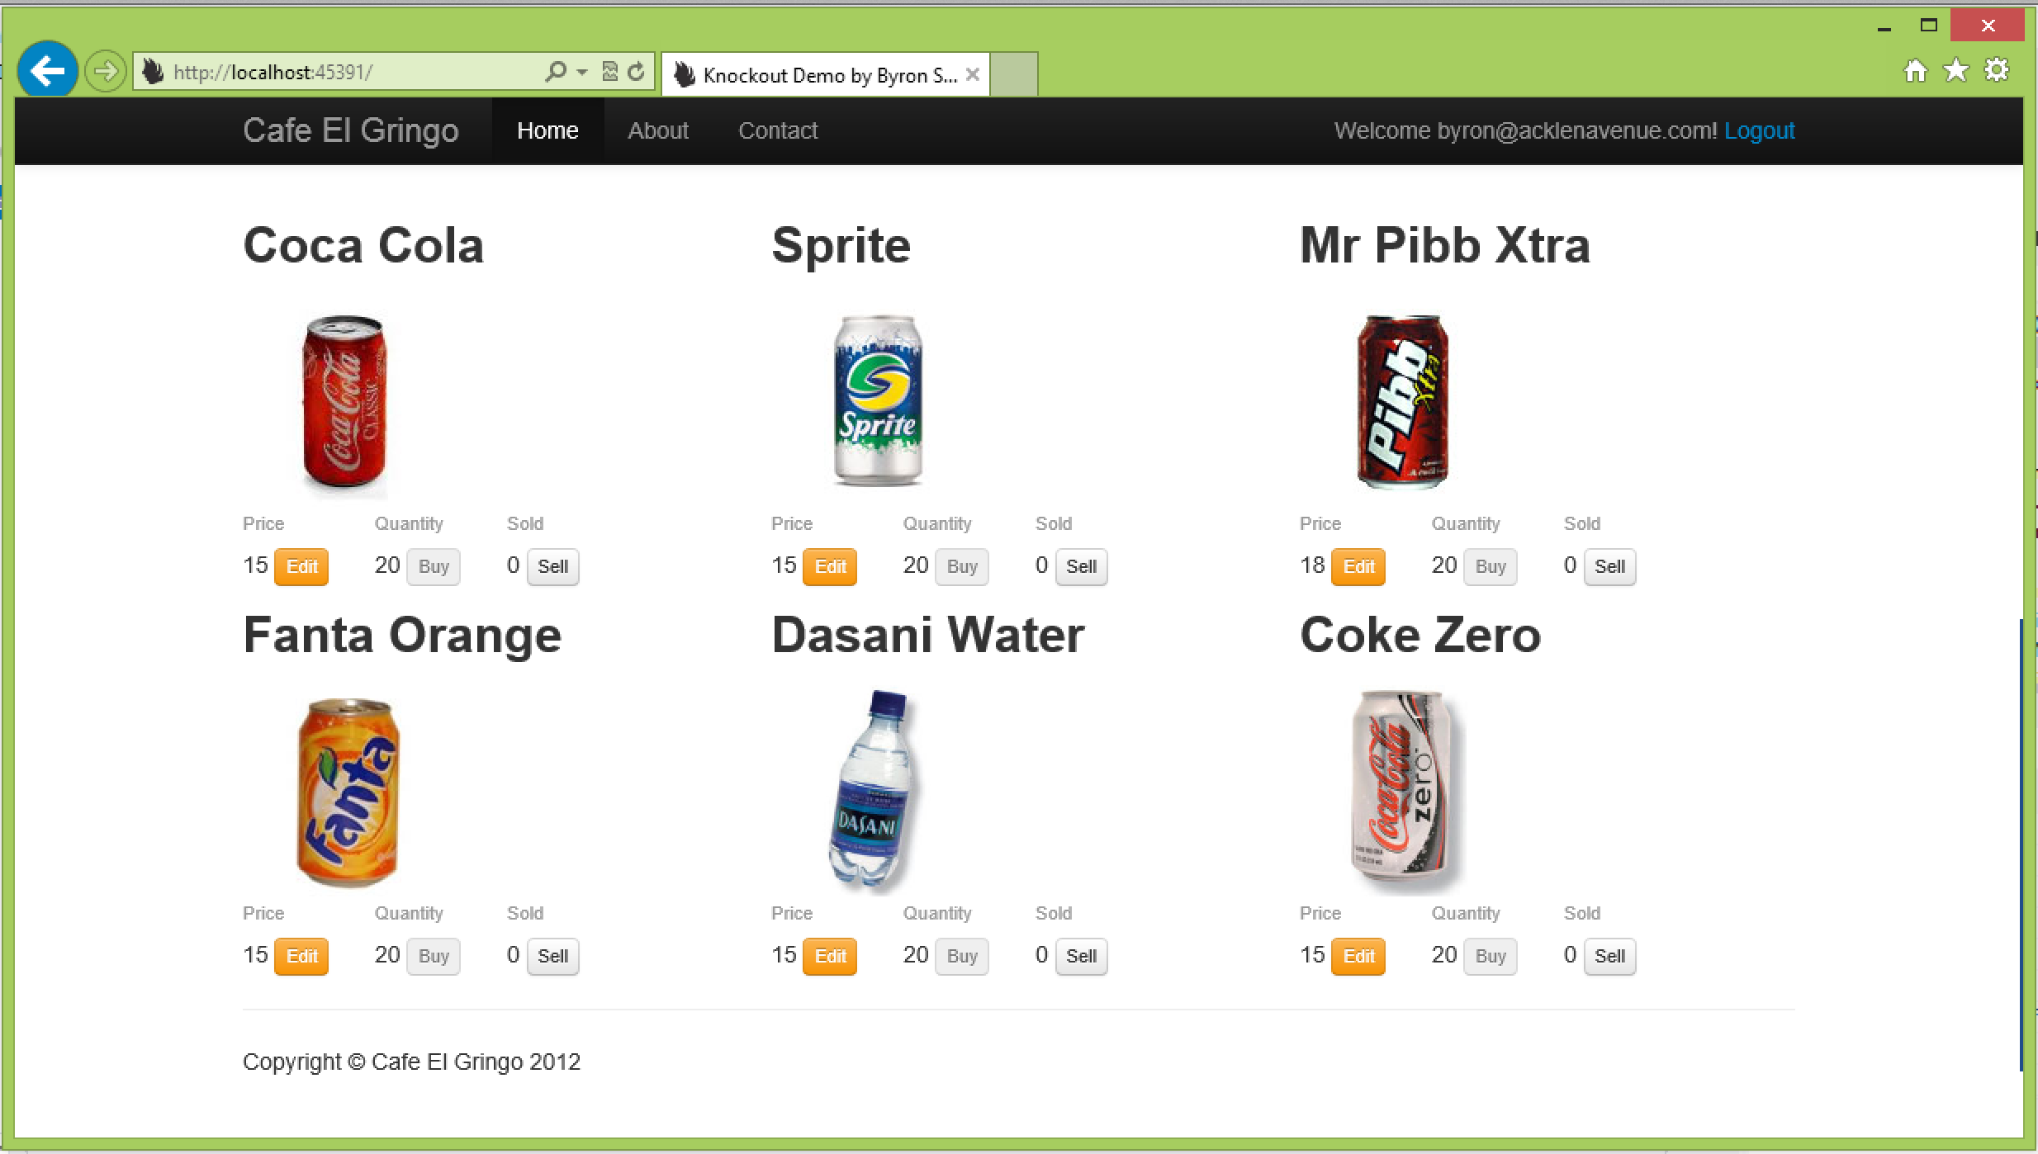
The finished product
An application that keeps track of the buying and selling of products.

Slide 4

Why is JavaScript important?
It is in every browser.
It runs on every screen.
It is a powerful language.
It is the future.
It is fun!

Slide 5

Why should I want a framework?
Quality
Cleanliness
Maintainability
Re-use
Team-Friendly

Slide 6

Why should I choose Knockout?
MVVM (makes sense for a stateful browser)
Documentation
Community Support
Endorsed by Microsoft

Slide 7

What is an API?
Not a “web service”.
Not “WCF”.
Provide server functionality to client.
With JSON, it’s lightweight
Can call it directly from jQuery.ajax().

Slide 8

What is a SPA?
A Full-Featured Website
A Rich User Experience
Works like a desktop application
One single html page (entry point)

Slide 9

Why are SPA’s important?
Reduce waste
Improve user experience
Re-use
More fun to code

Slide 10
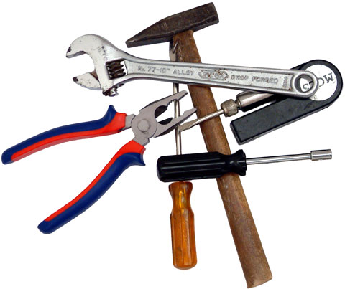
What tools/libraries will we use?
Knockout.JS
Web Server... windows/linux/whatever
API Provider… ASP.NET WebAPI or Nancy
jQuery & jQuery UI
Twitter Bootstrap
Toastr

Slide 11
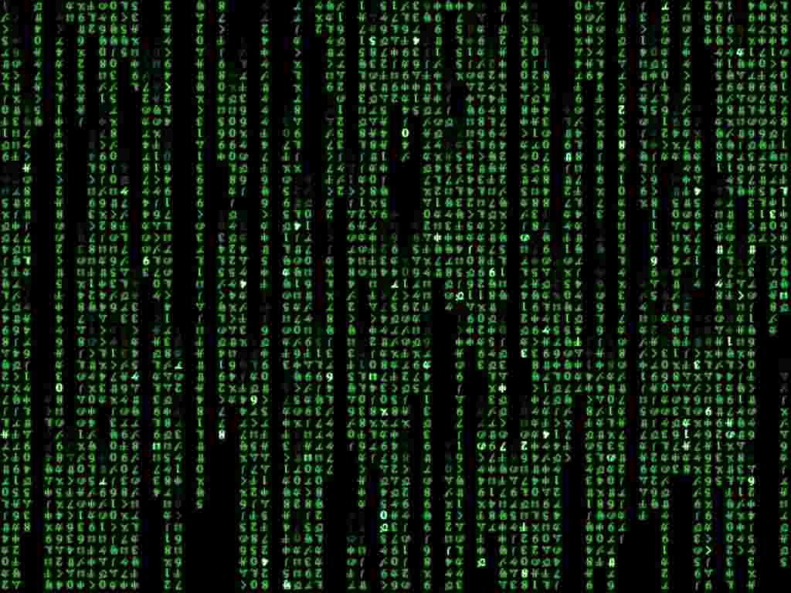
Show me the code!
Simple page, no login, get products from server
Add stats and formulas
Add buying and selling
Add constraint on buying
Add constraint on selling
Add edit, stats change after edit
Add delete
Add constraint on delete
Add login and separate content
Full Site Moved view models to folder

Slide 12

Byron Sommardahl
Get the Code!
github.com/bsommardahl
Santa Ana, Francisco Morazan
http://acklenavenue.com
Twitter: @sommardahl
Email: byron@acklenavenue.com

